Slide 1

3354.004 Final Project​
By:
Sydney Khamphouseng​
Adam Shafi​
Emma Tung​
Noah Lauer​
Lillian Chen ​
Anand Menon​
Hamdiya Abdulhafiz

Slide 2

Green Home is an eco-friendly online marketplace designed to provide environmentally-friendly household products with an aim to incentivize both providers and customers to reduce their carbon footprint.

Slide 3
Cost Estimation
Estimated Cost of Hardware
AWS Server:
$4.44/month
~$53.28/year
Estimated Cost of Software
IntelliJ IDEA Ultimate
$169/year per person
~$845/year for a team of 5 developers
Total Cost = $4,225/year
Jira Premium Plan
$15.25/month per person
~$122/month for a team of 8
~1,464/year for a team of 8
Figma Organization Plan
$45/month per person
$540/year per person
Total Cost = $2,700/year

Slide 4
Cost Estimation
Estimated cost of personnel
Product Manager = $15/hour * 8 hours/day * 5 days/week * 6 weeks = $3,600
Product Designer = $12/hour * 8 hours/day * 5 days/week * 6 weeks = $2,880
Software Developer (x5) $10/hour * 8 hours/day * 5 days/week * 6 weeks = $2,400/developer * 5 developer = $12,000
Quality Assurance Engineer $10/hour * 8 hours/day * 5 days/week * 6 weeks = $2,400
Total Cost = $3,600 + $2,880 + $12,000 + $2,400 = $20,880

Slide 5
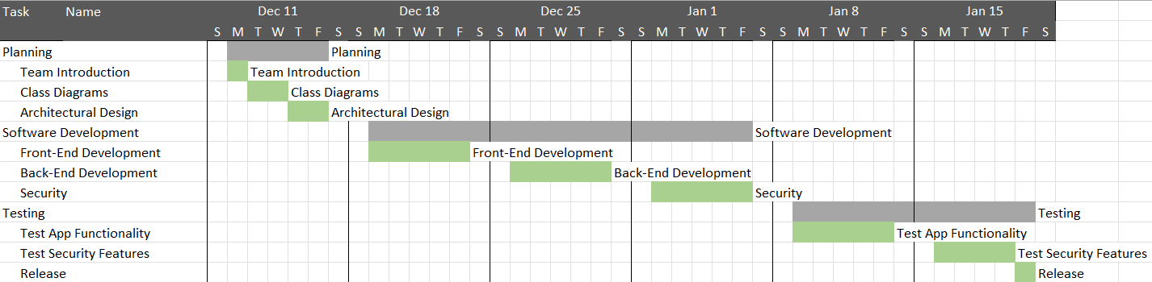
Project Schedule

Slide 6

Software Process Model
We choose the Waterfall process model
Utilizes sequential progression of steps
Was used to organize requirements, deadlines and guidelines for the project
Used to define project, decide programing language, data sources, and architecture.
Final stages of project include source code implementations, product testing, and final product presentation.

Slide 7
Functional Requirements
Customers must be able to create, modify and delete a user account
Customers must be able to browse, search, and filter products by criteria as a registered user or as a guest
Customers must be provided with a carbon footprint calculator.
Providers must be able to create, modify and delete a vendor account.
Providers must prove that products meet the environmental standards set by Green Home
Providers must be notified when one of their items have been purchased
Providers must be provided a tax break and incentive calculator if qualified

Slide 8
Non-Functional Requirements
Service must be available 24/7 with a downtime of at most ten (10) minutes
Sellers need to provide proof of legitimacy and verify they are a registered business.
Database to hold seller and user information
Any request made by customers or Providers must be handled in an average time of 5 secs.
Payment and customer information must be secure and protected.
System maintenance must not take more than 1 hour, and backups must be in place.
Systems must be in place to prevent unexpected downtime (e.g., from a DDoS)
Maintain lawyers on retainer to assist with legal regulations
Advertise ethical standards that will be maintained company wide.

Slide 9
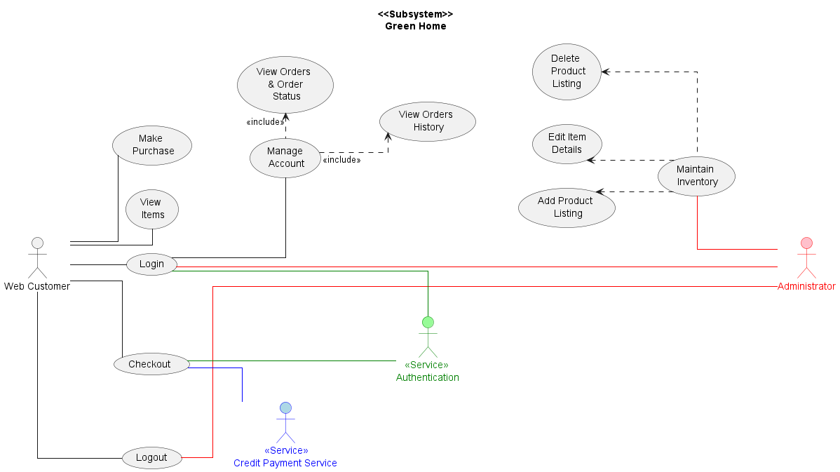
Top Level Use Case Diagram

Slide 10
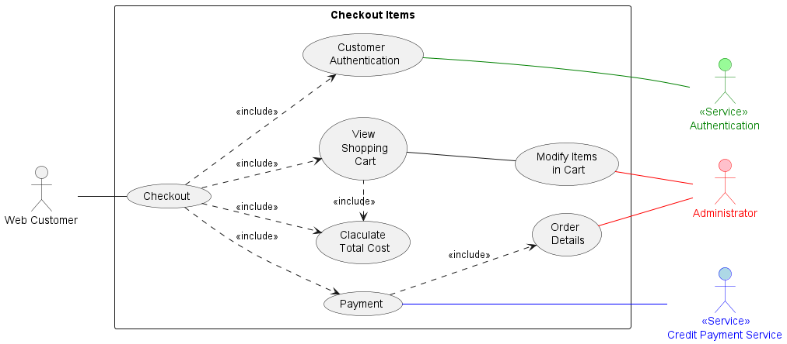
Checkout Items Use Case Diagram

Slide 11
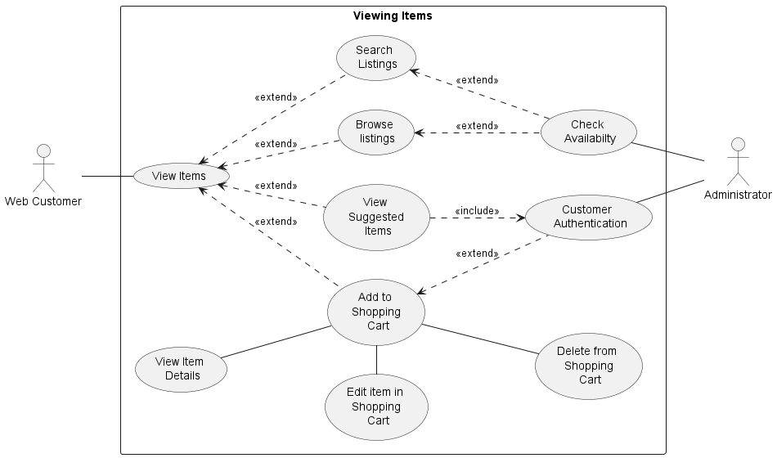
View Items Use Case Diagram

Slide 12

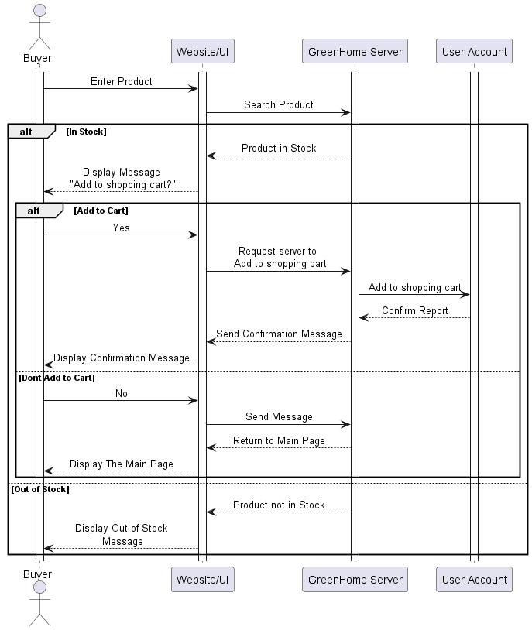
View Items Sequence Diagram
Control structure of events to view items in marketplace

Slide 13
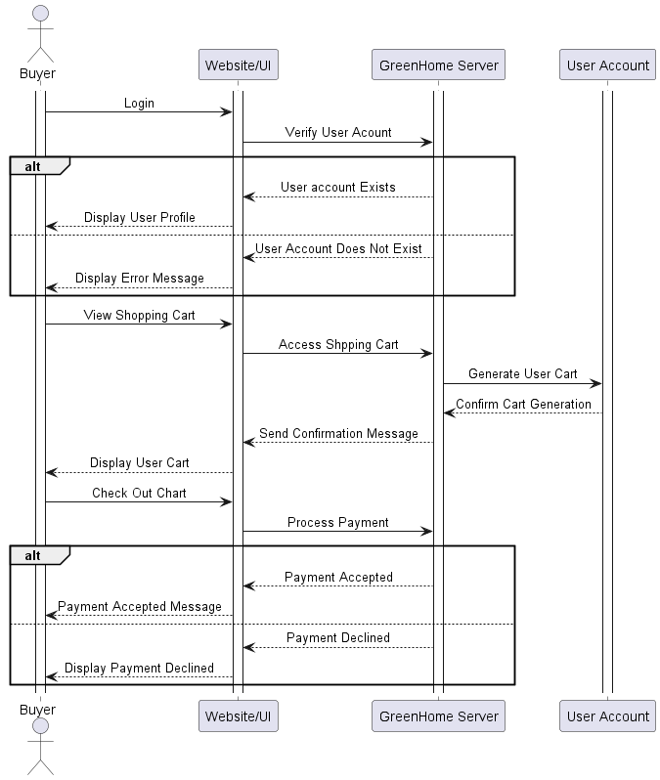
Checkout Sequence Diagram
Control structure of events to view items in Shopping care and pay for items

Slide 14
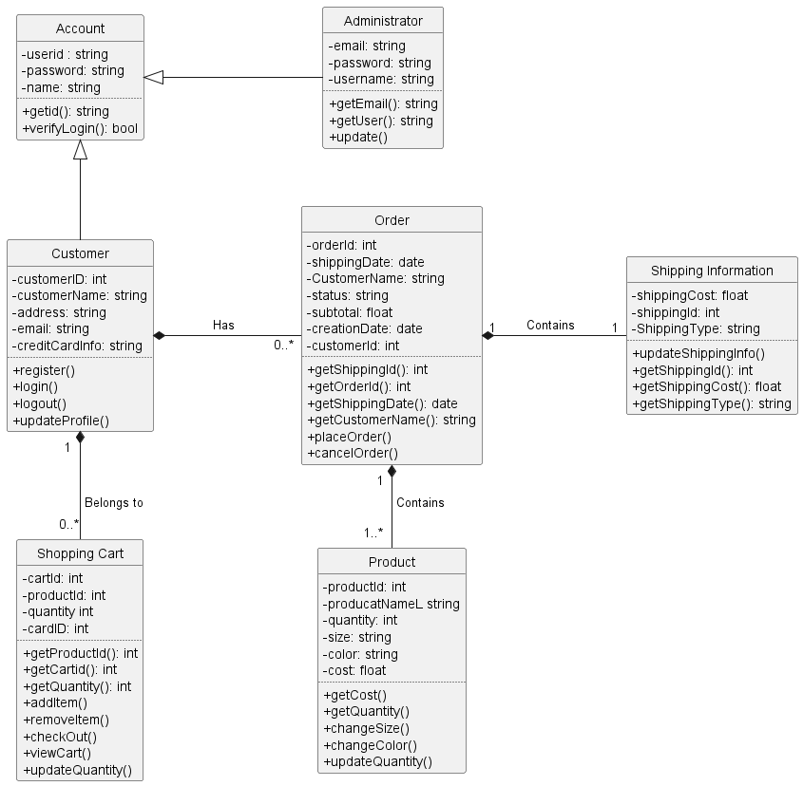
Class Diagram

Slide 15
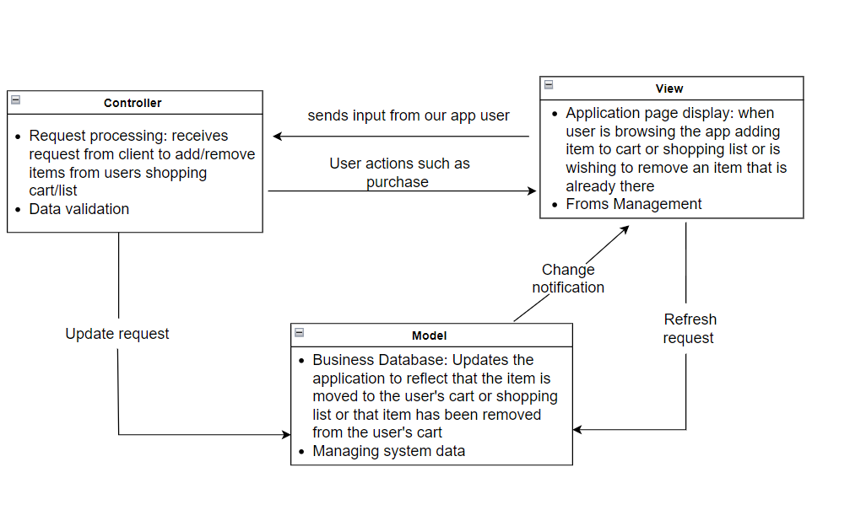
Architectural Design – MVC
MVC is allows client to make request to be handled by controller
Controller passes request to model to handle data logic
Model will then send response back to controller which will process the final view to the user

Slide 16
Pricing Estimation
Number of Screens: 7
Login
Accesses 1 data table (account info)
Homepage
View: Selection
View: Options
View: Account
Accesses 1 data table
View: Map
Catalog
View: Search screen
View: Product information
Shopping Cart
Checkout
Accesses data table (inventory)
Order Confirmation
Profile

Slide 17
Pricing Estimation
Reports
Catalog Report
1 section
Accesses 1 data table
4 3GL Components
Java: backend
CSS: frontend
JavaScript: frontend
React.js: frontend

Slide 18
Complexity Levels
For Screens |  |  |  | For Reports
# of Views Contained | # of data tables |  |  | # of Sections Contained | # of data tables
 | < 4 | < 8 | 8+ |  | < 4 | < 8 | 8+
< 3 | simple | simple | medium | 0 or 1 | simple | simple | medium
3-7 | simple | medium | difficult | 2 or 3 | simple | medium | difficult
> 8 | medium | difficult | difficult | 4+ | medium | difficult | difficult

Slide 19
Complexity Weight
Object Type | Complexity Weight
 | Simple | Medium | Difficult
Screen | 1 | 2 | 3
Report | 2 | 5 | 8
3GL Component |  |  | 10
Object Point (OP) count
7 (screens) + 5 (reports) + 40 (3GL components) =
OP = 52
New Object Points (NOPs)
~40% reuse
NOP = 52 x (100-40)/100 = 31.2
Screens: 7*1 = 7
Reports: 5*1 =5
3GL components: 4(10) = 40

Slide 20
Object Point Productivity
ICASE maturity & capability; Developers experience & capability | Low | Very Low | Nominal | High | Very High
PROD (NOP/ month) | 4 | 7 | 13 | 25 | 50
The development environment is low, and the team has little experience in the application domain (i.e., very low)
(7 + 4) / 2 = 5
Person-month effect:
31.2 / 5.5 = 5.68 person-month

Slide 21
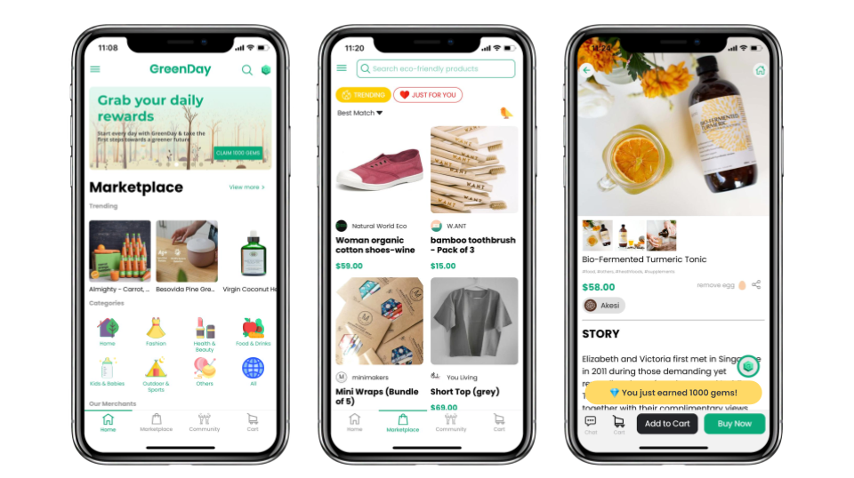
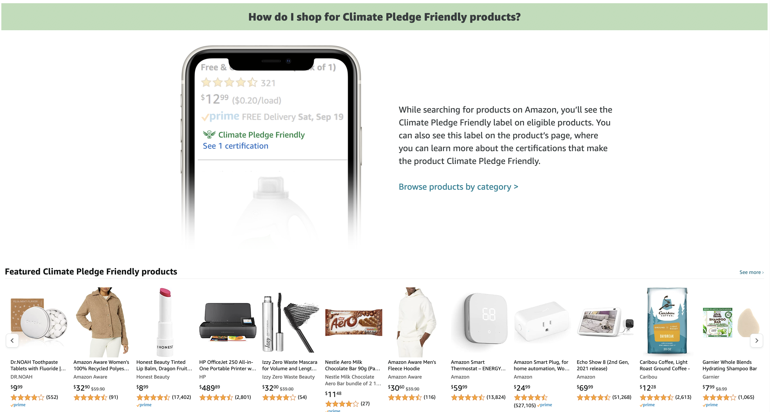
Green Home vs Other Apps
Amazon's Climate Pledge Friendly
GreenDay App

Slide 22
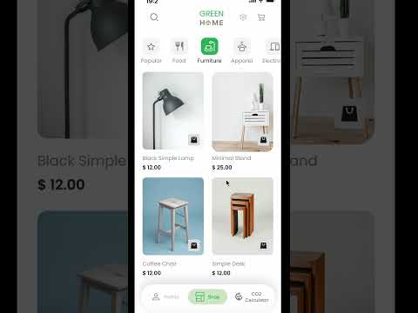
DEMO

Slide 23
Conclusion & Future Plans
Our project is Green Home, a user-based application that helps users find environmentally-conscious alternatives to household consumer products. Our project went smoothly and did not have any serious changes due to group planning and collaboration.

